Slide 1

Dracula’s Library
Project By:- ​
Jody​
Darpan​
Katie

Slide 2
Technologies Used
Front End
Back End
Testing
Description:
Used HTML, CSS, JavaScript.
Description:
Used Java for adding Server-side logic
Database is PostgreSQL in Amazon RDS
Description:
Postman to check the server side workings without front end being implemented.
Selenium Cucumber testing.
Manual Testing.

Slide 3

Different Phases
Brainstorming
01
02
Requirements
Development
03
04
Testing
Brainstorming to identify the project to be developed.
Prepared requirements as an end users.
Developed based on the requirements.
Tested based on the requirements identified

Slide 4
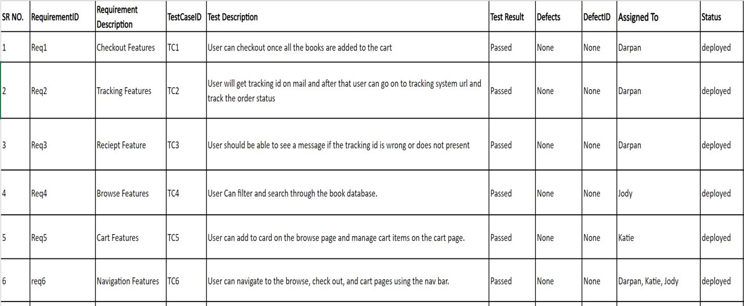
Requirements Traceability Matrix

Slide 5

DEMO
LET’S HAVE A

